Slide 1

Smart Traffic - Smart City
City Pulse Project

Slide 2
Smart City -City Pulse Project
The World is transforming into a digital era. Cities need to be modify to meet citizens expectations
Smart City solutions utilize IoT and Social Media data to deliver higher-quality citizen services efficiently. In addition to that, there is a chance to save an organization's operational cost, that affects city businesses and people's quality of living.
CityPulse is one of such project. It processes large-scale data from Internet of Things and social networks.

Slide 3
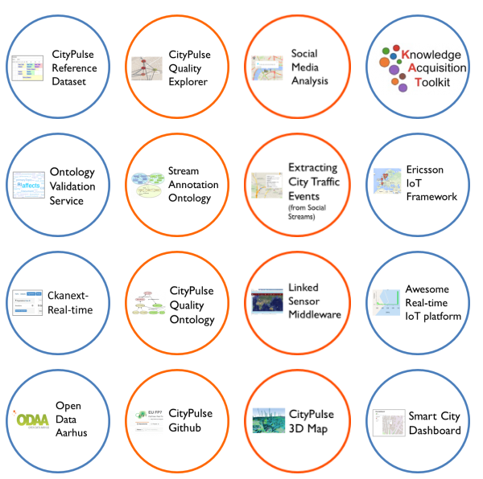
City Pulse Project - Main Components
City Pulse is the project developed by a nine different organizations.
These are the tools and applications that Citypulse project provides.

Slide 4
Road Data
Since we are using Road dataset, we focus on the Smart city Dashboard application.
Road data consists of two different types of data files.
First type is metadata. There is a separate metadata file for each individual city.
Metadata file consists of streets geographical information of a city and Report_ID.

Slide 5
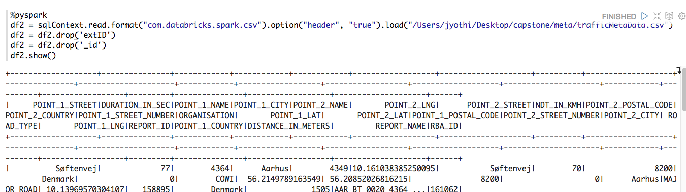
Metadata

Slide 6
Traffic Data
Other type of data is street traffic data, which is in csv format. Each file represents individual street traffic information.
Each line abstracts traffic information of every five minutes.
Important attributes in this file, are timestamp, average speed, number of vehicles, REPORT_ID.
Both datasets can be combined by REPORT_ID

Slide 7
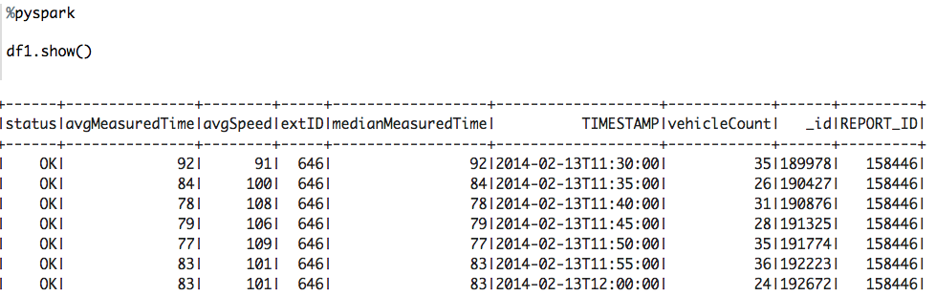
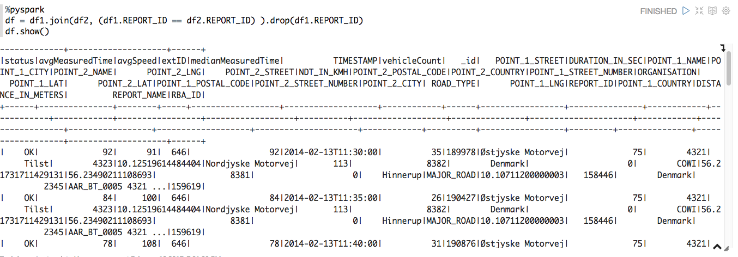
Traffic Data
Merged Data

Slide 8
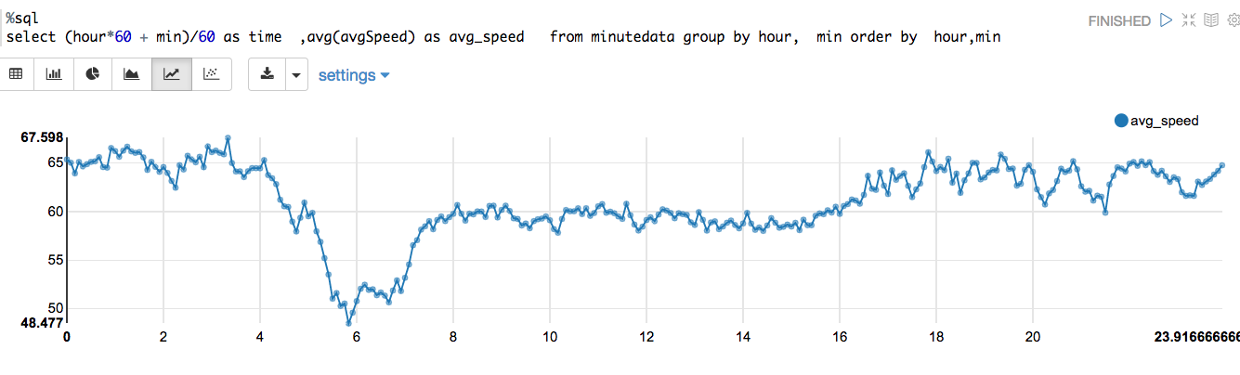
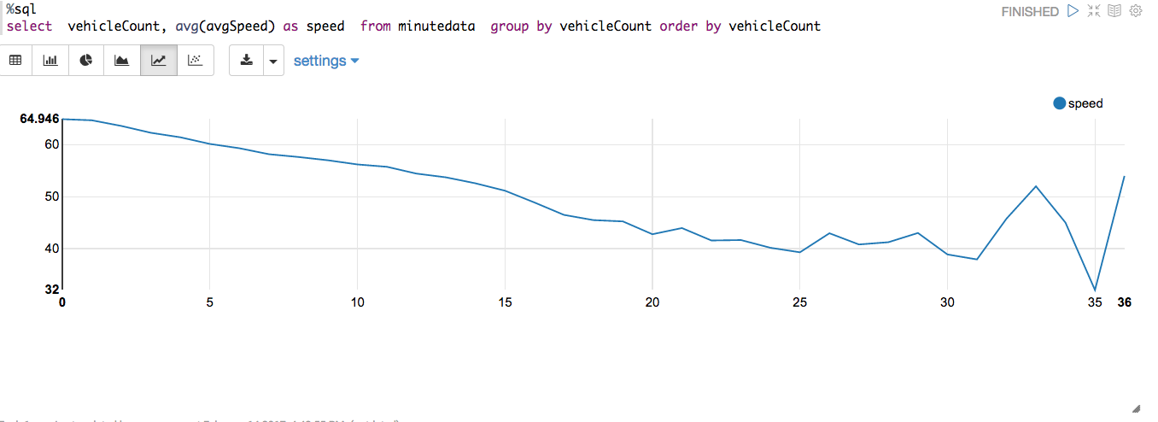
Data Visualization
Avg Speed Vs Hour of the day
Avg Speed Vs Vehicle Count
Notes:
Average Speed higher at night time compared to daytime(Only sample data taken)
As vehicle count increases average speed reduces till some point

Slide 9
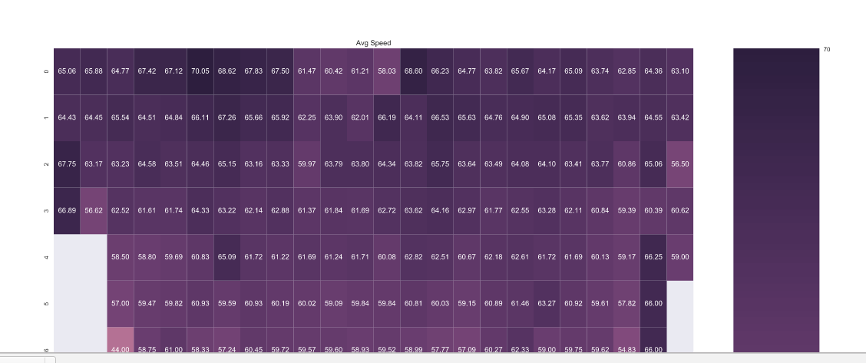
Heat Map - Average Speed
X- Axis ==> Hour
Y- Axis ==> Vehicle Count
Cell ⇒ Avg Speed
Histogram of Average speed : https://plot.ly/~jkunaparaju/101

Slide 10
City pulse Dashboard
City Pulse dashboard is an application which visualizes traffic, parking and event information.
There are three different sections in the dashboard.
Left section is a placeholder for user selection. User can select various criteria, which will be used to query data from backend and display information in the map
Map with city traffic information appears in the middle.

Slide 11
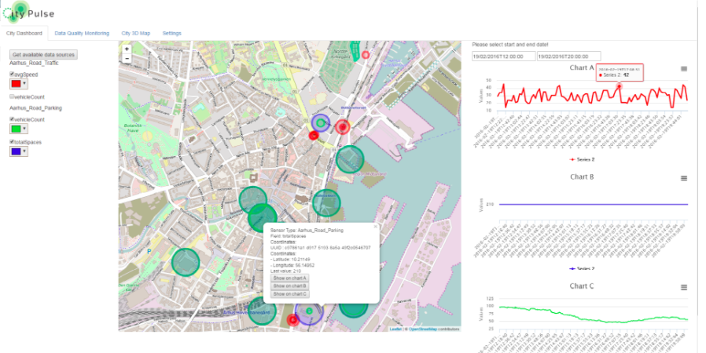
City Pulse DashBoard
Notes:
Now we are going to use Road data set created by city pulse project we focus on dashboard application.

Slide 12
City Pulse dashboard contd..
The rightmost section is for visual analytics from historical data.
When a user chooses Aarhus city, list of available data sources are populated. After selecting datasources he/she will be able to choose color of the marker to display in map.
After submitting the request, map will be populated with markers for each sensor. Size of the marker will be proportional to size of the data.

Slide 13
City Pulse dashboard contd..
When user hovers over the sensor, the tooltip will be displayed with more details about the sensor. For example, Geographic data like Latitude, Longitude, Street Name etc.
Rightmost part of the screen, there is a section where domain expert can view some visualizations of historic data.

Slide 14
Design Improvements
The aim of this project is to create application for users(Administrators and Citizens) to make use of cutting edge technologies.
There will be two major extensions to the existing system
First one will be applying unsupervised learning to create clusters.
Second one is to provide better user experience by improving graphical user interface(GUI).

Slide 15
Clustering
Clustering is, division of data into groups of similar objects.
Create spatial, temporal clusters to predict future behavioral prediction of traffic.
Clusters might reveal patterns, for example at different times of a day, there may be different spatial distributions.
During the morning peak hours, the largest targeted road cluster located in one area. However, during the evening period, same cluster may not found.

Slide 16
Clustering
Different spatial distributions of the targeted road clusters in weekdays and weekends, indicating that demand for detailed travel information.
This would lead to more accurate estimations of traffic congestions.
By observing these patterns, we can rank road segments by their traffic flow. With this, road network efficiency can be improved.
Historical traffic patterns can be used for the prediction of traffic flows and also for the correction of missing or erroneous data.

Slide 17
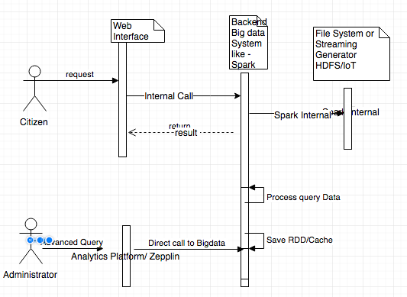
Process flow - Sequence Diagram
The above Sequence diagram shows process flow. Whenever user requests for information, a http request will be generated and processed with spark and response will be sent back user.

Slide 18
User Experience Improvement
This project improve user experience by two ways.
First one, Instead of showing all details in one single page, three different modules created. Those are User Authentication, Map, Analytics.
User authentication will store user details for future purpose
Map module show traffic data based on user requests
Administrator can run analytics on third module.

Slide 19
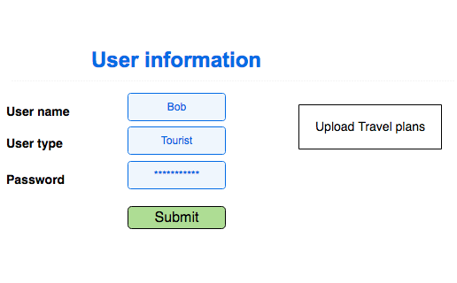
User Authentication
When ever user comes in, this module stores user information. After submitting the request, user redirected to Map page.

Slide 20
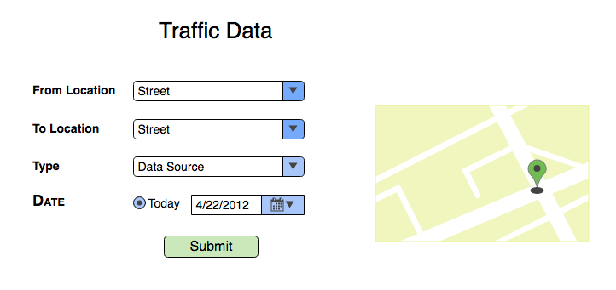
Traffic data display
User selects street, type of resource and Date. Traffic data displayed in map.

Slide 21
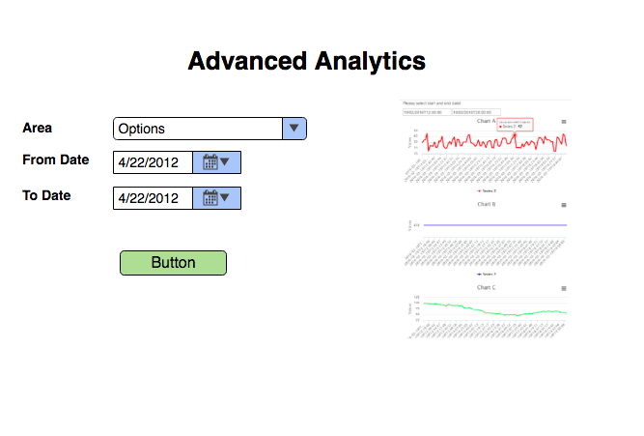
Advanced Analytics on historic data
This page is for city administrators. They can visualize historic as well as streaming data.

Slide 22
Conclusion
This project, once implemented, is an improvement to existing city pulse project and a guideline for future research.
It uses most advanced tools and technologies. That makes this application scalable in future.
By using spark Structured streaming we will be able to combine both current data and historic data and run analytics on real time.

Slide 23
References
https://github.com/CityPulse/Documentation/blob/master/Year%203%20Reports%20and%20Deliverables/CityPulse_D5.3_Smart_City_Environment_User_Interfaces_Final.pdf
https://www.youtube.com/watch?v=XDO5RnzJHCY
https://www.draw.io/
https://app.moqups.com/jkunaparaju/sURdTg12RV/edit/page/ad64222d5
http://www.ict-citypulse.eu/page/content/consortium

